Slide 1
LENDING CLUB CASE STUDY
SUBMISSION

Slide 2
Objectives:

Slide 3
Problem solving methodology
1. Data Understanding
2. Data Cleaning
3. Data Analysis
4. Recommendations

Slide 4
Step 1 : Data understanding
1. Understanding the Shape of the data (Rows, Columns)
There are 39717 rows and 111 columns before data cleaning.
2. Check if the data in the data frame is consistent such that there is no misplaced data between columns.
3. Check the data types of the data to see if the quantitative values are int/float and categorical is object / String
4. Understanding the Outliers
5. Understand the presence of Null/ NaN values in columns and in rows in general
6. Understand the variables against data dictionary
7. Understand the variables from the column names
8. Understand the variables importance to gain domain knowledge by browsing though the internet

Slide 5
Data Cleaning
1. Remove the Columns which contain 90% or more Null values
2. Check individual variables including Target variable and perform data cleaning to remove outliers, and to impute the data where Null/NaN is present or to remove them.

Slide 6
Data Analysis
1. The irrelevant variables are identified (e.g. behavioral variables ) and are ignored from further analysis.

Slide 7
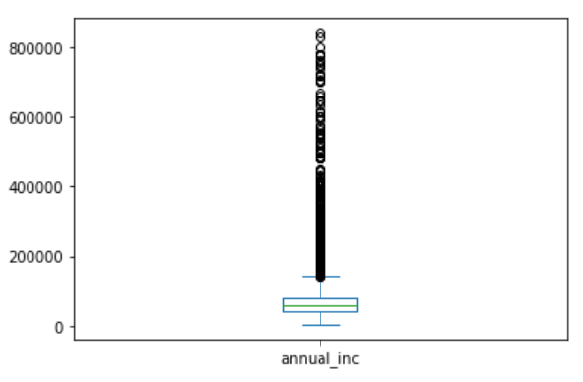
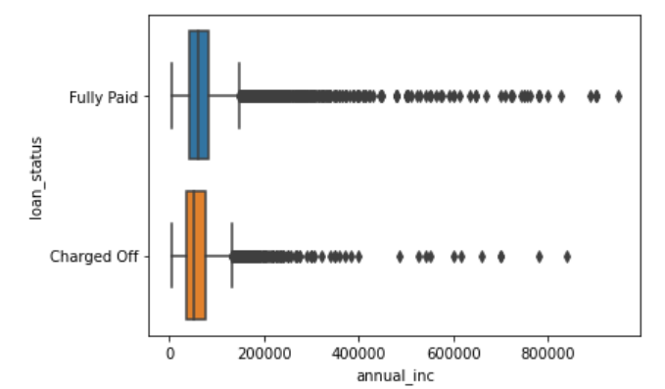
Univariate & Bivariate Analysis used to remove outliers and to clean up the data.
After removing extreme outliers from the income group, there are still more values above the upper whiskers. As those contains representative higher income group useful in the analysis, I have decided not to remove them. Then I analyzed the Loan status against Annual income and removed income range above 840000 as there are no Charged Off cases above that range.

Slide 8
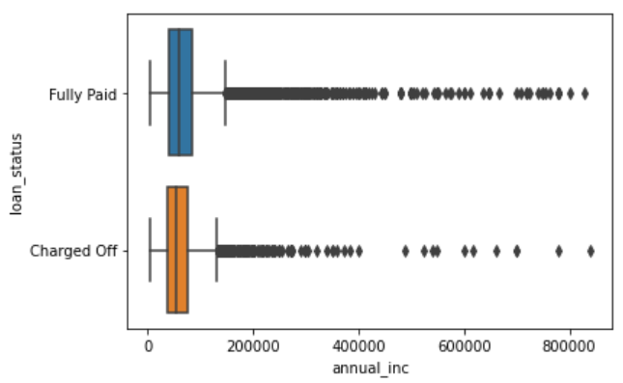
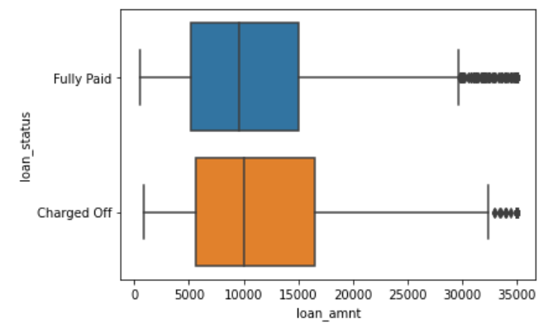
Univariate Analysis

Slide 9
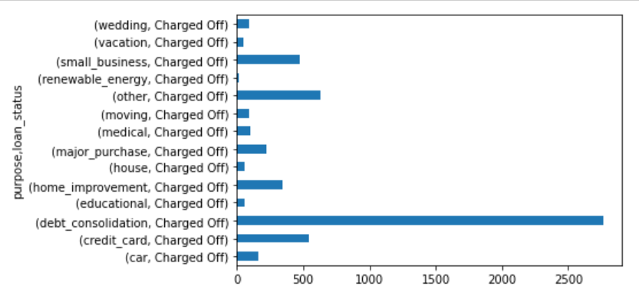
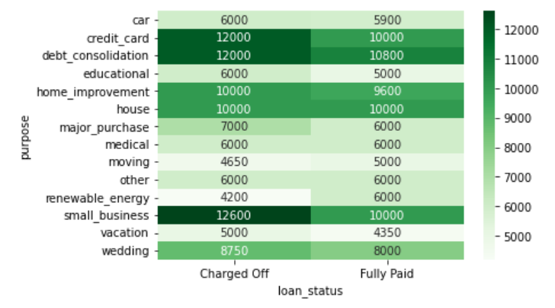
Loan Status vs Purpose
Purpose vs Loan status
Purpose vs Loan status vs Loan amount
The loan_amount taken for creditcard,debt_consolidation,small_business are among the top 3 Charged Off

Slide 10
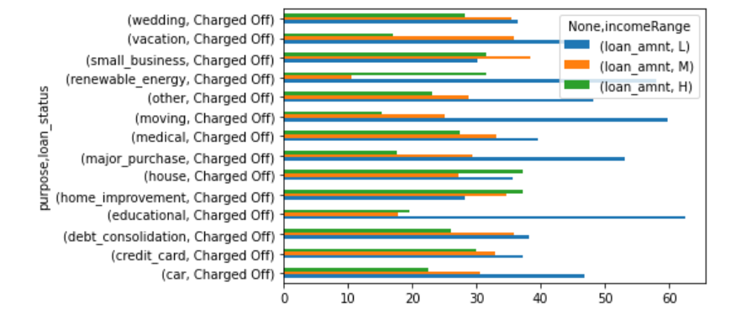
# Analysis of Percentage of Purpose against Annual income range and loan status
On percentage analysis,Low income group creates more charge_offs when they apply for educational,moving,renewable energy loans.

Slide 11
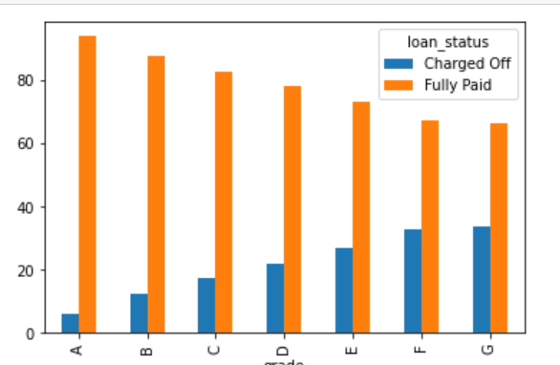
Analysis of Percentage of Loan applicants charged off against grade and Loan status (Charged Off , Fully Paid)
# Inference from the analysis above : The percentage of chargeoff increases with risk represented by higher Grades

Slide 12
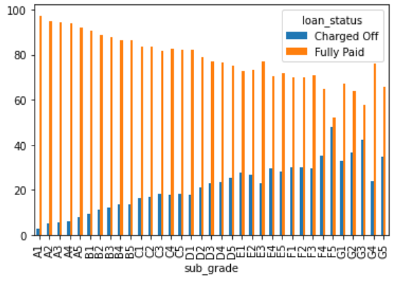
Analysis of Grade against Loan status
# Inference from the analysis above : The higher the subgrade, the higher the percentage of ChargeOff

Slide 13
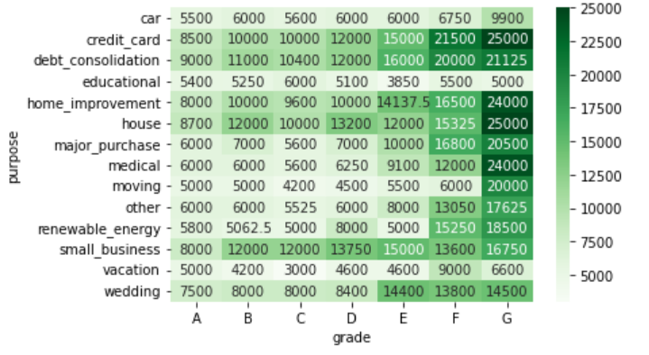
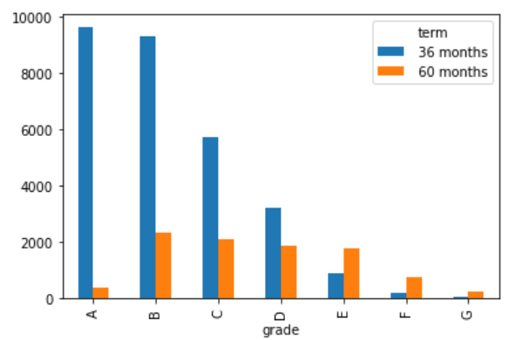
Additional analysis of Purpose , Grade , Loan amount
Analysis of Grade vs Purpose, Loan amount
Analysis of Grade , Loan Term
# Inference from the analysis above : High risk group needs loan more for credit_Card,medical,home_improvement purposes
# Inference from analysis above : while the credit score deteriorates, people tend to go for long term loans.

Slide 14
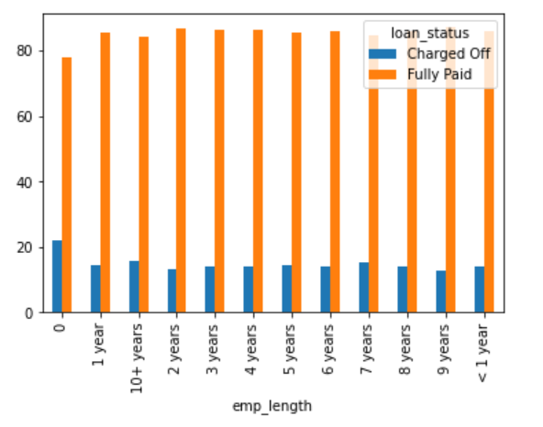
Analysis of Employment length vs Loan Status
#Inference from the analysis : People with '0' employement length have more percentage of chargeoff

Slide 15
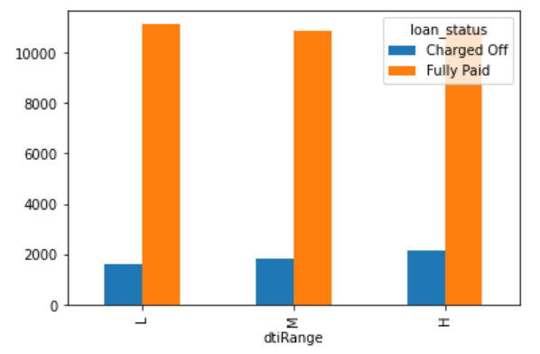
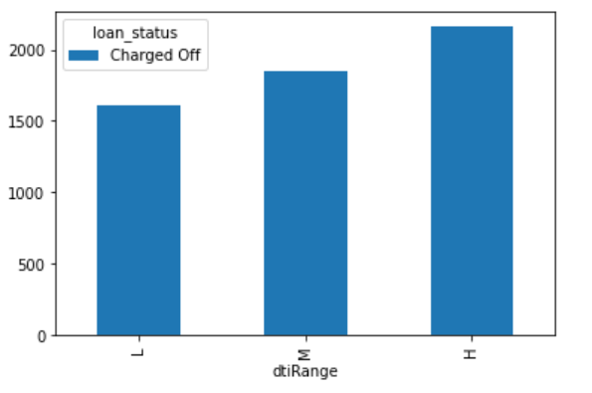
Analysis dti against loan status
# Inference from the analysis above : higher the Dti then higher the charged Off

Slide 16
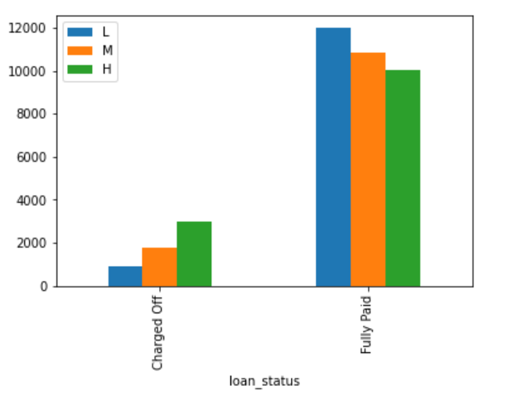
Analysis of Interest rate against Loan status
# Inference from the analysis above : High interest rates get more charged Off while Low interest rates gets fully Paid

Slide 17
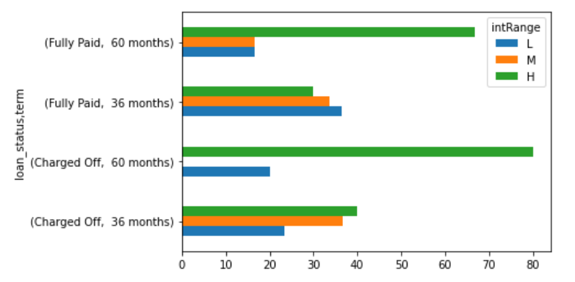
Analysis of Loan status, Term and Interest range specifically for educational loans
# Inference from the analysis above : For educational loans, when the interest rate is high, Low income group will get more charged Off for short term and long term loans.

Slide 18
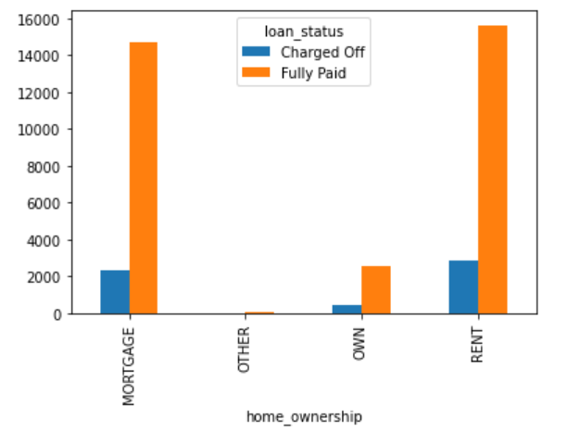
Analysis of Home ownership against Loan status
# Inference from the analysis : People who lives in Rented accommodation and those who has mortgage has more charged off than people who has Home ownership.

Slide 19
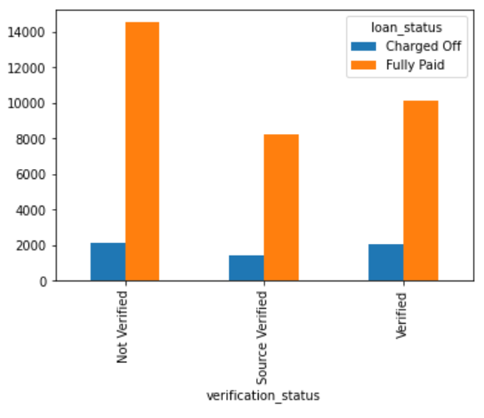
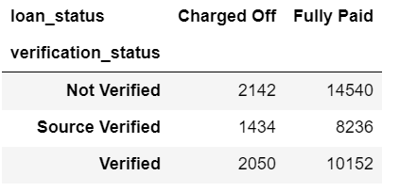
Analysis : Verification status against Loan status
# Inference from the analysis : The charged off cases of people with 'Not Verified' verification status is slightly high compared to others.

